Slide 1



Capstone Business Analysis
project
www.roopambarua1996.com

Slide 2


Content
01
About the project
02
Data-set Summary
03
Statistical Test
04
Data cleaning and Excel chart
05
Inserting Data into SQL
06
Importing data from SQL to Power BI
07
Power BI Dashboard
08
Insights and Questions
09
Conclusion

Slide 3



About the Project
In this project we will get to know about the various tools used in business analysis and get a through understanding of the data set provided by working with various tool deriving insights from the data.
We will also learn importing data into various software like Excel, SQL and Power BI and perform data cleaning along with dashboard creation in Power BI.

Slide 4



Summary of the Data-set
This data set of is of two financial years (2013-2014) give us a comprehensive understanding about the product sold to different countries, the segment in which they belong , the manufacturing cost of the product, the number of units sold , the discount offered on the product and the dates in which the product has been shipped.
Lastly the cost of goods sold, the gross sales of the product in different country and profit earned in the entire transaction.
With this data information we get to know about the growth rate of the company year on year secondly we can get to know which product is getting more demands in the countries and how much profit was earned from there so that in future we can keep the stocks ready by the particular date to deliver to that country in which demand is maximum and predict the product or segment on which we have to make changes for improvement ,which will optimize the growth and efficiency of the company.

Slide 5

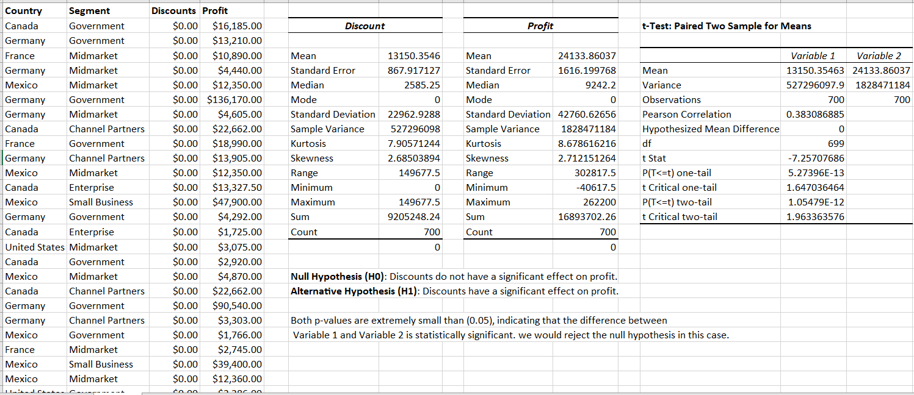
Statistical Tests
Performed t-test to find out if there is any effect on the profit by offering attractive discounts on the product.
The test failed to reject the null hypothesis which means there is a significant increase in profit by offering discounts.

Slide 6


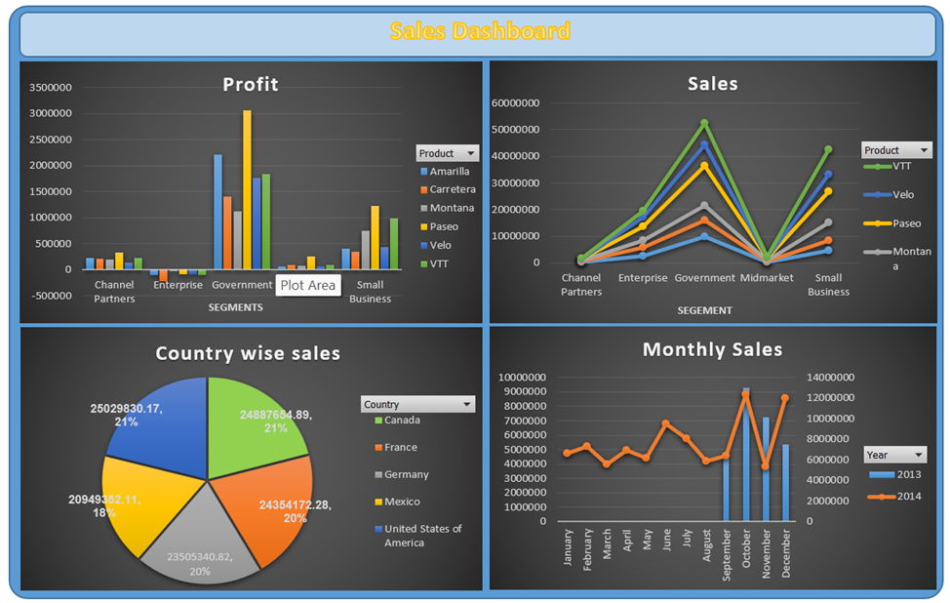
Data cleaning and Excel Charts
Performed data cleaning and inserted pivot table to manage the data and charts to visualize.
Insights
The highest selling product is VTT.
Max profit is earned from government and most profitable product is Paseo.
However there is loss in segment enterprise.
Sales in U.S.A is the maximum which is around 21.6 % of the total sales.
Maximum sales done in the last quarter of both the year, most active month is October.

Slide 7

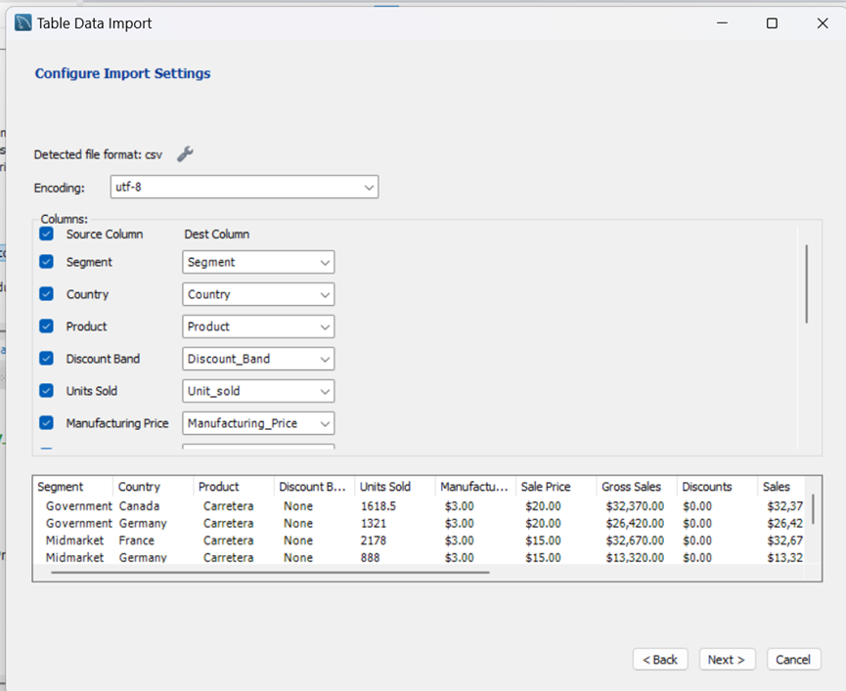

Inserting data into SQL
Converted the Excel data-set from .xlsx to .csv file type and imported in MySQL by creating a database(Testbook) and creating table(Western_County_Finance) with the same column as mentioned in the data-set, using “table data Import” option we can insert the data in the database.

Slide 8


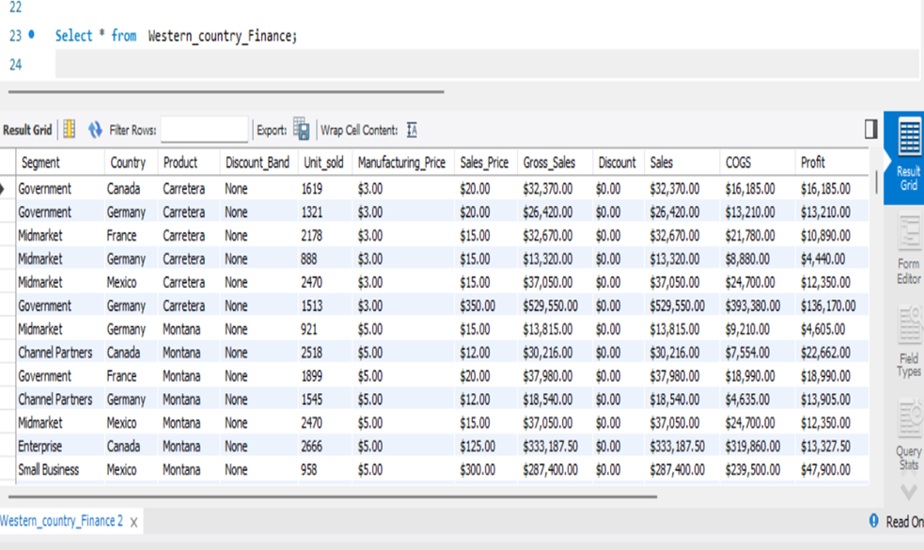


Inserting data into SQL
Data inserted successfully and checked using “Select” query Statement.
customers

Slide 9
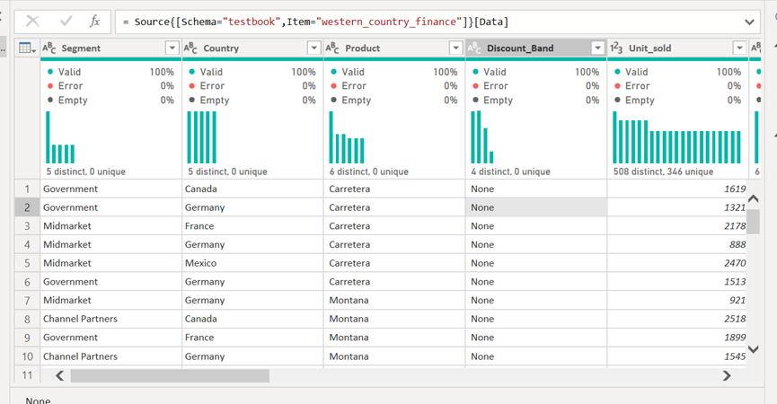
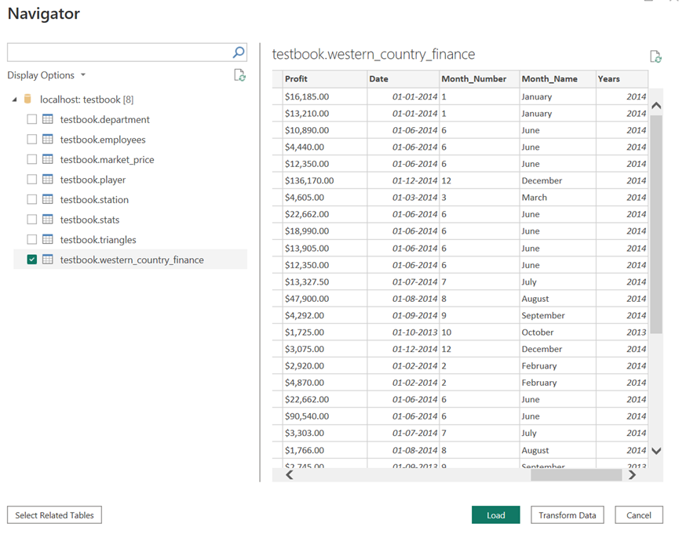
Importing Data from SQL to Power BI
Imported the data successfully using “import data SQL server database” and “server Id”, checked for any error or blanks spaces in “Power Query Editor”

Slide 10
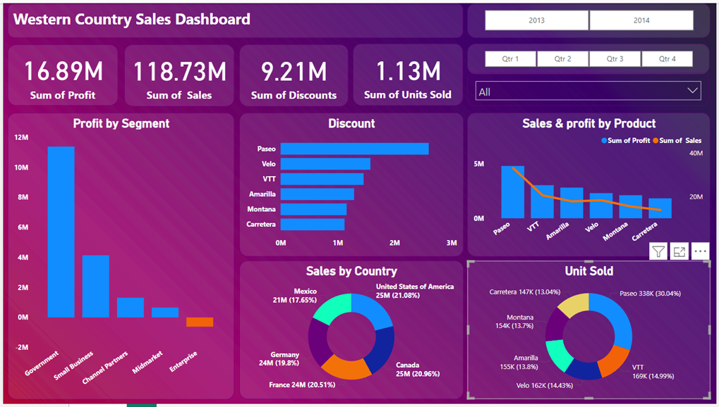
Power BI Dashboard
Dashboard includes clustered column chart, clustered bar chart, line and clustered column chart, donut chats, cards and filter for year, quarter and months.

Slide 11
Insights and Questions
➔Product wise Sales:
➔Country wise Sales
Amarilla: $ 17747116.06
Carretera: $ 13815307.89
Montana: $ 15390801.88
Paseo: $ 33011143.95
Velo: $ 18250059.47
VTT: $ 20511921.02
➔Yearly sales
Canada: $ 24887654.89
France: $ 24354172.28
Germany: $ 23505340.82
Mexico: $ 20949352.11
U.S.A: $ 25029830.17
2013: $ 26415255.51
2014: $ 92311094.75
➔Yearly profit
➔Segment wise Profit
➔Profit and sales by Quarter
Channel Partners: $ 1316803.14
Enterprise: $ -614545.625
Government: $ 11388173.17
Midmarket: $ 660103.075
Small Business: $ 4143168.5
2013: $ 3878464.51
2014: $ 13015237.75
Profit
Sales
Quarter 1: $26,32,442.94
Quarter 2: $32,32,378.45
Quarter 3: $35,01,667.37
Quarter 4: $75,27,213.50
$1,94,92,152.94
$2,26,93,879.95
$2,48,50,239.87
$5,16,90,077.50

Slide 12
Insights and Questions
➔No. of units sold year over year
➔Top 2 countries
Canada
France
2013: 264674
2014: 861132
➔Product wise discount
➔Bottom 3 products
Amarilla: $ 1290163.44
Carretera: $ 1122212.615
Montana: $ 1159032.62
Paseo: $ 2600518.05
Velo: $ 1576709.035
VTT: $ 1456612.48
Velo
Montana
Carretera

Slide 13
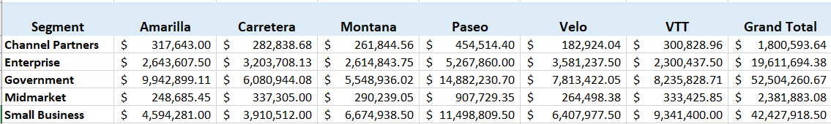
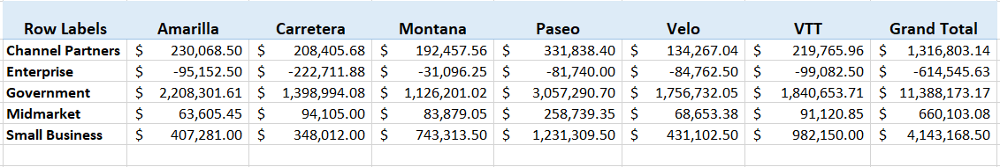
Insights and Questions
➔Segment wise Product Sales
Segment wise product wise profit

Slide 14
Conclusion
In conclusion, the sales landscape in Western countries is marked by high levels of competition, consumer-driven markets, and a strong emphasis on innovation and customer experience. Businesses in these economies leverage advanced technologies, data analytics, and e-commerce platforms to enhance their sales strategies and meet the evolving needs of a diverse consumer base. While factors such as economic shifts, regulatory changes, and global competition pose challenges, companies that prioritize adaptability, personalized offerings, and sustainable practices continue to thrive. Moving forward, businesses must remain agile and forward-thinking to capitalize on emerging trends and maintain their competitive edge in the Western sales markets.

Slide 15

Thank You!

